Slide 1
Storytelling Mindset Transforming Tech Careers By Crafting Powerful Connections
OLIVIA STOICESCU
ML & Data Professional
Owner Fashioned SoftWorks B.V.

Slide 2
Have you ever felt so connected with a person during a conversation…
that time seemingly stood still?

Slide 3

Resonance

Slide 4
On the other hand…

Slide 5
Have you ever heard someone speak and just felt off?

Slide 6

Dissonance

Slide 7
Let’s continue with a story

Slide 8


Slide 9


Slide 10


Slide 11


Slide 12
What do I learn about you from your story?
How can I relate to you from what I have learned?

Slide 13
Agenda
Shifting mindsets: fact finder vs storyteller
The mechanics of good storytelling
Workshop (interactive)
Conclusions

Slide 14
Agenda
Shifting mindsets: fact finder vs storyteller
The mechanics of good storytelling
Workshop (interactive)
Conclusions

Slide 15
Initial success
Any human is a pure rational being.
By focusing on arguing facts and objective truths:
communication becomes clear
outcomes become more predictable

Slide 16
Head-to-head communication
The assumptions are clear and can be referred to.
The truth of any proposition then depends entirely on the assumptions and the logical steps.
Once some propositions are established, they can be used to establish others.

Slide 17
Does this sound like you?

Slide 18
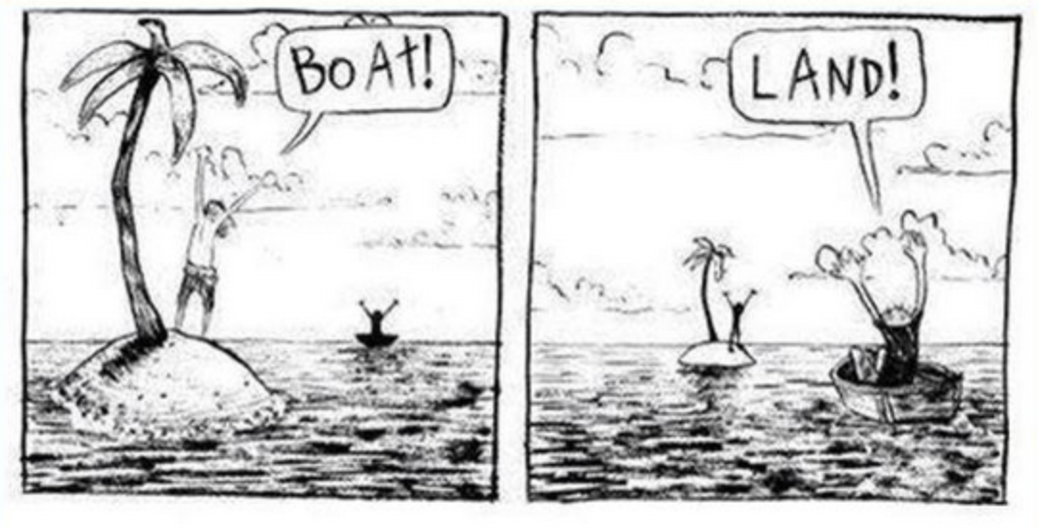
Real world is messy

Slide 19
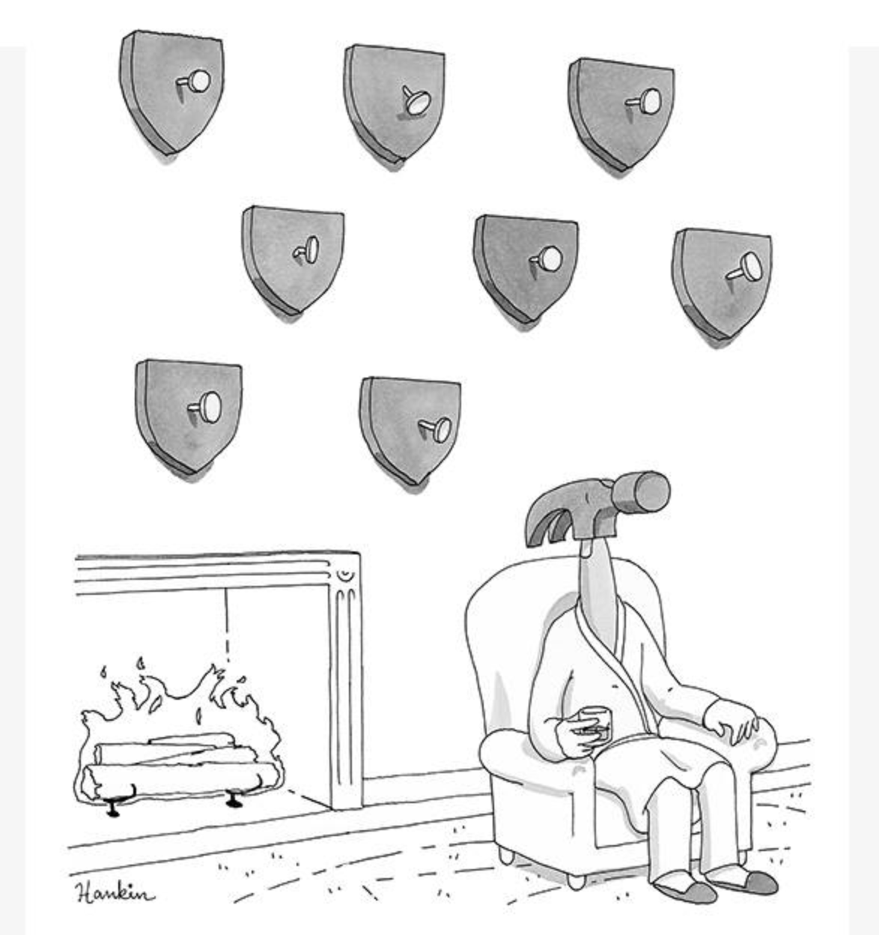
Not every problem is a nail for the logic hammer

Slide 20

The default mindset: the fact finder
When communicating facts, the areas of the brain that get activated are the ones responsible for language processing.

Slide 21
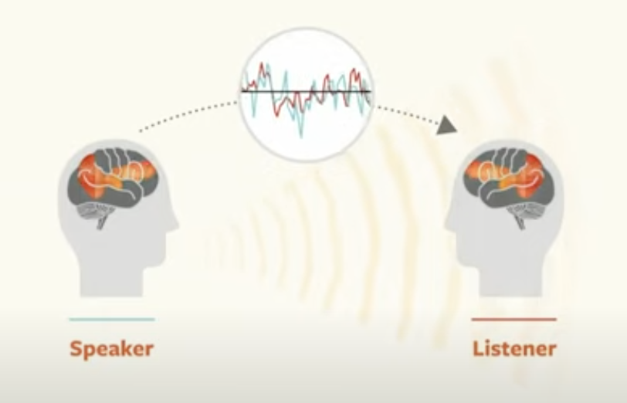
The storyteller
We are moving ourselves inside the story.
…if that were me, what would I do?

Slide 22
Facts are important, but they are not everything.
facts
information
stories

Slide 23

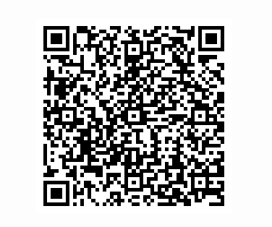
Agenda
Shifting mindsets: fact finder vs storyteller
The mechanics of good storytelling
Workshop (interactive)
Conclusions

Slide 24
Where can we find great stories?
movies/books, current events
things that happened to a person close to you (friend, mentor, co-worker)
a time you shined
a time you blew it

Slide 25
What makes a good story?
A great story makes you feel something.
You are not just listening to a story, you are making yourself part of it.

Slide 26
The hook
Grab the attention of your audience by starting with a hook.
Unusual, unexpected, contains a conflict.
Music is part of everyone's lives.
It will always be around, so it is a very large target market all around the world.
But interestingly enough, in this whole digital revolution, there is no market leader.
https://www.youtube.com/watch?v=kN0SVBCJqLs

Slide 27
The promise
Keep their attention by making a promise for change.
How is what I will learn going to make me better?
No one has really found the recipe yet, for digital music.
And we think, not only can we find the recipe, but we think the Apple brand is going to be fantastic, because people trust the Apple brand to get their great digital electronics from.
https://www.youtube.com/watch?v=kN0SVBCJqLs

Slide 28
Be authentic
A story with heart creates resonance.
Use what you know. Draw from it.
Make it personal.
Don’t be clever.
Be vulnerable and honest.

Slide 29
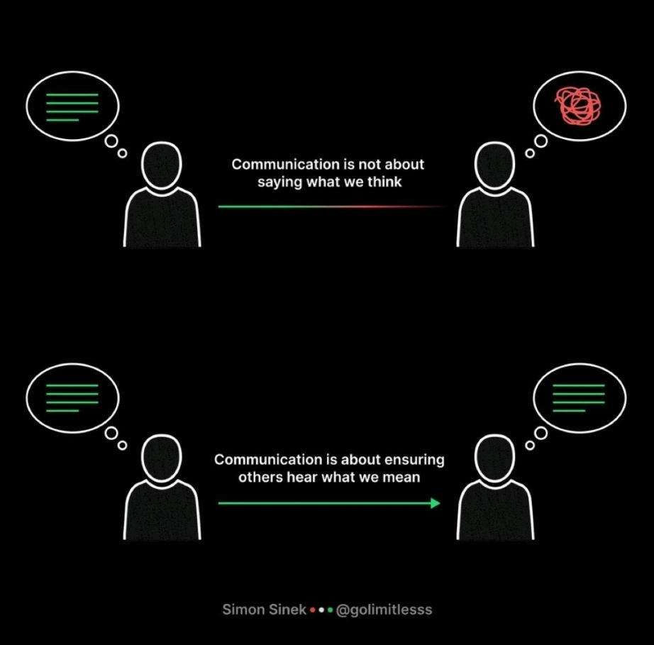
Tune the message to your audience
Speak to them on their level.
Identify their aspirations or fears and speak to those.

Slide 30
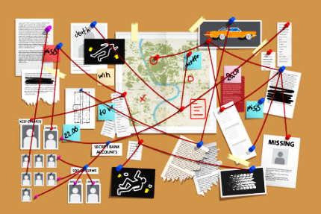
Build suspense
Drama is anticipation mingled with uncertainty.
People are born problem solvers.

Slide 31

Delivery
Beginning -> setup
Middle -> build
End -> payoff

Slide 32
Types of stories
Who-I-Am stories
Why-I-Am-Here stories
Teaching stories
Vision stories
Value-In-Action stories
I-Know-What-You-Are-Thinking stories
Annette Simmons - Whoever tells the best story wins

Slide 33
Who-I-Am stories
Show the steps and experiences that created who you are today.
What qualities earn you the right to influence this person?
Think of a story that demonstrates one (or more) of the qualities you listed.

Slide 34
Why-I-Am-Here stories
What is in it for you?
What is my purpose for being here?

Slide 35
Teaching stories
Trial-run by imagination.
No-risk demonstration.
Scrooge’s ghosts are taking Scrooge on Teaching-story tours

Slide 36
Vision stories
Tell a worthy and exciting future story, that reframes present difficulties as ‘‘worth it.’’
Don’t overpromise: validate the difficulties of achieving your vision

Slide 37
Value-In-Action stories
Tell a story about a time you had a chance to embody a value through actions.
Your goal is to tell stories about doing the ‘‘right’’ thing in tough circumstances.

Slide 38
I-Know-What-You-Are-Thinking stories
Share their “secret” suspicion in a story that:
first validates
and then dispels these objections
without sounding defensive.

Slide 39
Agenda
Shifting mindsets: fact finder vs storyteller
The mechanics of good storytelling
Workshop (interactive)
Conclusions

Slide 40
Workshop structure
Walk-through: how to build a story
Spend 10 minutes of quiet time to come up with your story
Volunteers can share their own stories

Slide 41
Quick references
Theme
Interviewing
Give a technical presentation
Craft a career path
Building Steps
Source the story
Decide on the type of story
Use the elements to build a good story
Practice delivery

Slide 42
Providing feedback
What I like about your story is . . .
What your story tells me about you is. . . .
How will hearing your story transform our relationship . . .
I can see you using this story when ( situation)... in order to (impact) . . .

Slide 43
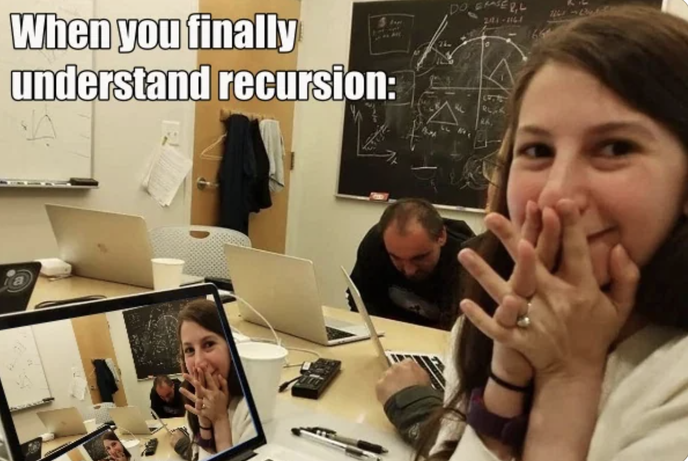
Conclusion
When we are listening to a story, we are ultimately looking at ourselves.

